Slide 1
Business Intelligence G. Mudare

Slide 2
Market basket analysis

Slide 3
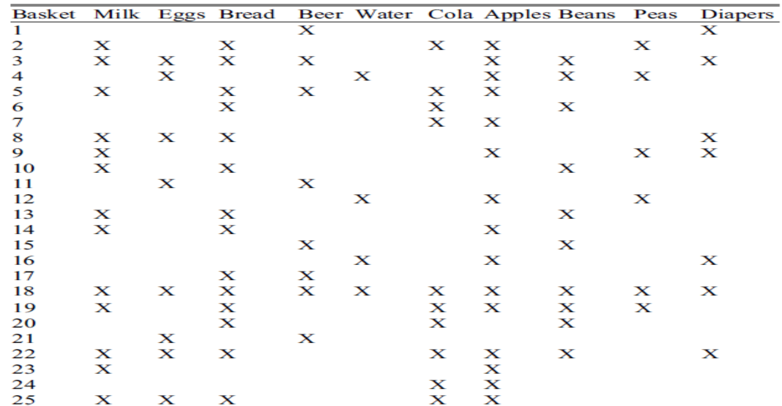
Market basket analysis
Given below is a dataset consisting of 10 grocery items, with 25 market baskets.

Slide 4
Market basket analysis
Find the support for :
apples and milk
beer and water
How many pairs will be generated if the minimum support is 1
Which item pairs are below the minimum support of 2,
Which item pairs meet the minimum support of 10
Which item pairs meet the minimum support of 5
If bread was in a market basket, what is the confidence that milk would also be in the basket?
If milk was in a market basket, what is the confidence that bread would also be in the basket?
If eggs were in a market basket, what is the confidence that apples would also be in the basket?

Slide 5
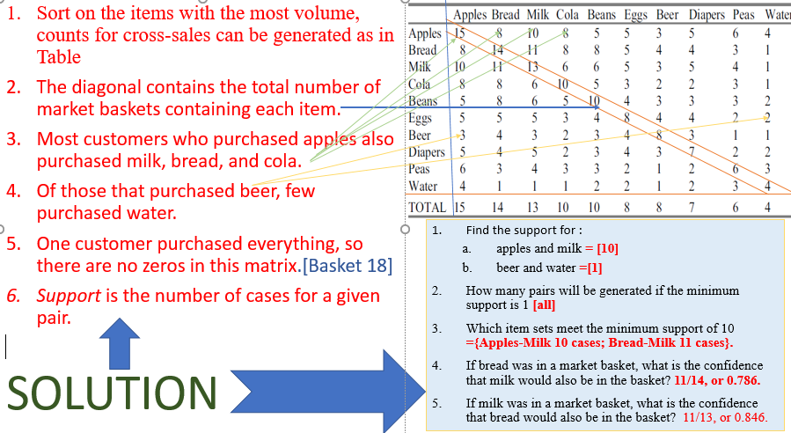
SOLUTION

Slide 6
Improving the Efficiency of Apriori
Hash-based technique (hashing itemsets into corresponding buckets):
Transaction reduction (reducing the number of transactions scanned in future iterations):
Partitioning (partitioning the data to find candidate itemsets):
Sampling (mining on a subset of the given data)
Dynamic itemset counting (adding candidate itemsets at different points during a scan):

Slide 7
Hash-based technique
A hash-based technique can be used to reduce the size of the candidate k-itemsets, Ck, for k > 1.
For example, when scanning each transaction in the database to generate the frequent 1-itemsets, L1, from the candidate 1-itemsets in C1, we can generate all of the 2-itemsets for each transaction, hash (i.e., map) them into the different buckets of a hash table structure, and increase the corresponding bucket counts
A 2-itemset whose corresponding bucket count in the hash table is below the support threshold cannot be frequent and thus should be removed from the candidate set

Slide 8
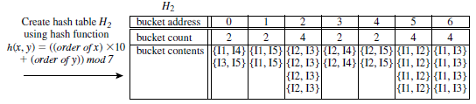
Hash-based technique
Hash table, H2, for candidate 2-itemsets:
This hash table was generated by scanning the transactions of thae dbTable while determining L1 from C1.
If the minimum support count is, say, 3, then the itemsets in buckets 0, 1, 3, and 4 cannot be frequent and so they should not be included in C2.

Slide 9
Transaction reduction
Reducing the number of transactions scanned in future iterations):
A transaction that does not contain any frequent k-itemsets cannot contain any frequent (k+1)-itemsets.
Such a transaction can be marked or removed from further consideration because subsequent scans of the database for j-itemsets, where j > k, will not require it.

Slide 10
Partitioning
Partitioning the data to find candidate itemsets):
A partitioning technique can be used that requires just two database scans to mine the
It consists of two phases.
In Phase I, the algorithm subdivides the transactions of D into n nonoverlapping partitions. If the minimum support threshold for transactions in D is min sup, then the minimum support count for a partition is min sup the number of transactions in that partition.
For each partition, all frequent itemsets (local frequent itemsets) within the partition are found.
The procedure employs a special data structure that, for each itemset, records the TIDs of the transactions containing the items in the itemset.
A local frequent itemset may or may not be frequent with respect to the entire database, D. Any itemset that is potentially frequent with respect to D must occur as a frequent itemset in at least one of the partitions.
Therefore, all local frequent itemsets are candidate itemsets with respect to D.
The collection of frequent itemsets from all partitions forms the global candidate itemsets with respect to D.

Slide 11
Partitioning
In Phase II, a second scan of D is conducted in which the actual support of each candidate is assessed in order to determine the global frequent itemsets.
Partition size and the number of partitions are set so that each partition can fit into main memory and therefore be read only once in each phase.

Slide 12
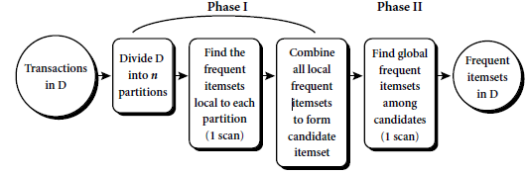
Partitioning

Slide 13
Sampling
Mining on a subset of the given data: The basic idea of the sampling approach is to pick a random sample S of the given data D, and then search for frequent itemsets in S instead of D.
In this way, we trade off some degree of accuracy against efficiency.
The sample size of S is such that the search for frequent itemsets in S can be done in main memory, and so only one scan of the transactions in S is required overall.

Slide 14
Counting
Adding candidate itemsets at different points during a scan the database is partitioned into blocks marked by start points.
In this variation, new candidate itemsets can be added at any start point, unlike in Apriori, which determines new candidate itemsets only immediately before each complete database scan.
The technique is dynamic in that it estimates the support of all of the itemsets that have been counted so far, adding new candidate itemsets if all of their subsets are estimated to be frequent.
The resulting algorithm requires fewer database scans than Apriori.

